Slide 1

Orange Packaging

Slide 2
Table of contents
01
02
03
04
05
06
Introduction
Changes
People, Profit, Planet
Market!
Impact of Changes
Testing Evidence

Slide 3
01
Introduction

Slide 4
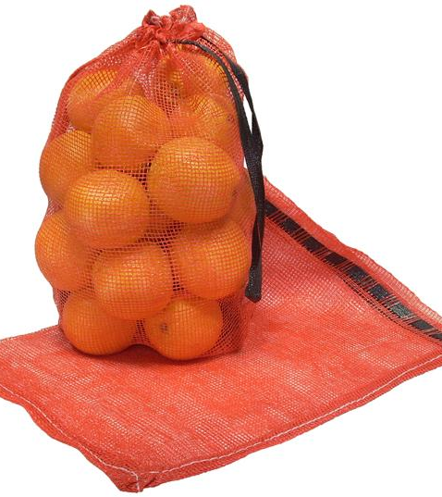
Orange Mesh (Polypropylene) Bagging
Orange mesh bags are typically derived from polypropylene (PP) due to it’s renown toughness, durability, and elasticity for individual PP strands. A cost effective material that is utilized in many bagging applications for medical and agricultural.

Slide 5
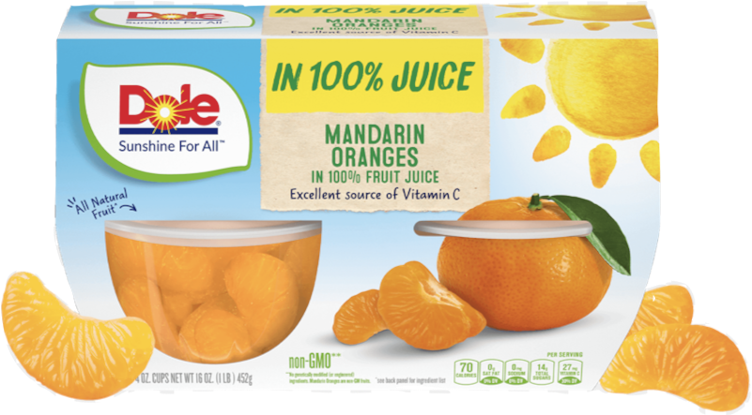
Fruit Cups
Mandarin Orange fruit cups have many aspects to their packaging that contribute to this product’s “easy snack” nature. Most plastic in the packaging is polypropylene ethylene (PPE).

Slide 6
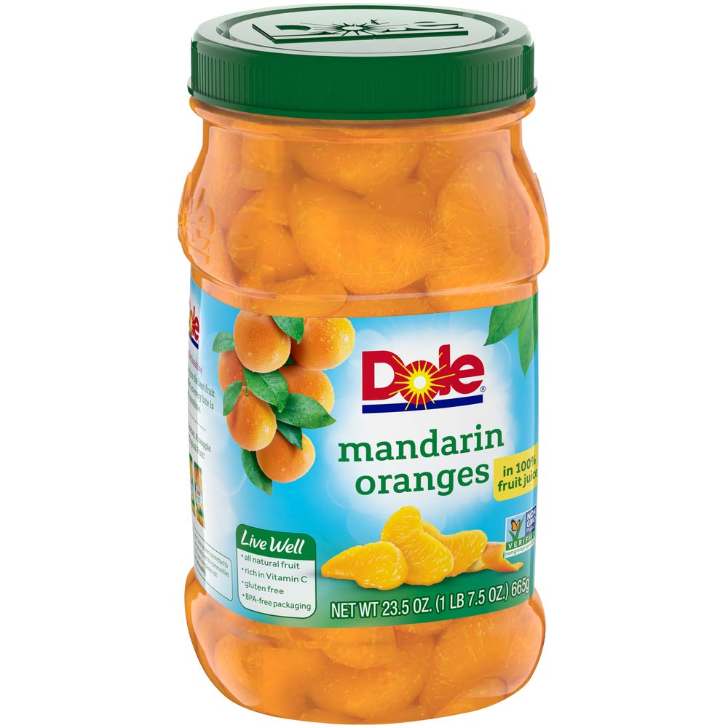
Product Information: Oranges
Navel
Mandarin
Most often used in bagged packaging and stored in cardboard boxes
46-50% of households consume navel oranges
78-92% of navel orange are consumed at home
Majority of navel oranges produced domestically in California, Texas, and Florida
Second most popular orange citrus, behind navel
Packaging focus on protection and reducing contamination
Higher source of Vitamin A, but lower in Vitamin C and fiber
Popular because they are easier to peel/prepare and sweeter
92% of mandarin oranges sourced from California and Mexico.

Slide 7
02
People, Profit, and Planet

Slide 8
People/Stakeholders
Who are they?
Consumers
Farmers
Oil Drilling
Bagging Manufacturers
Vendors/Grocery
Investors/Shareholders
Government
Needs
Wants
Easy to open
Easy to carry
Disposable
Nutritious / Safe
Cheap
Sustainable packaging: reusable and recyclable
Quick “grab and go” snack
Visually Appealing
Disposal
Health Effects
Landfill
Recyclable
Compostable
FTIR results of the fruit cups reveal high amounts of phthalates and PFAS in all levels of the packaging. Both are connected to endocrine, neurological, and developmental health effects.

Slide 9
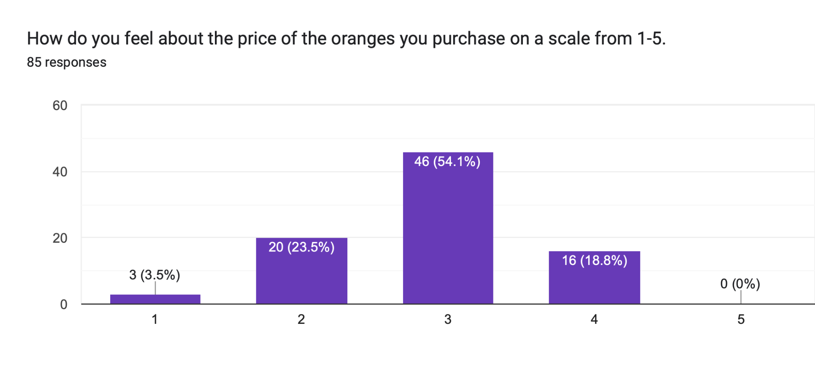
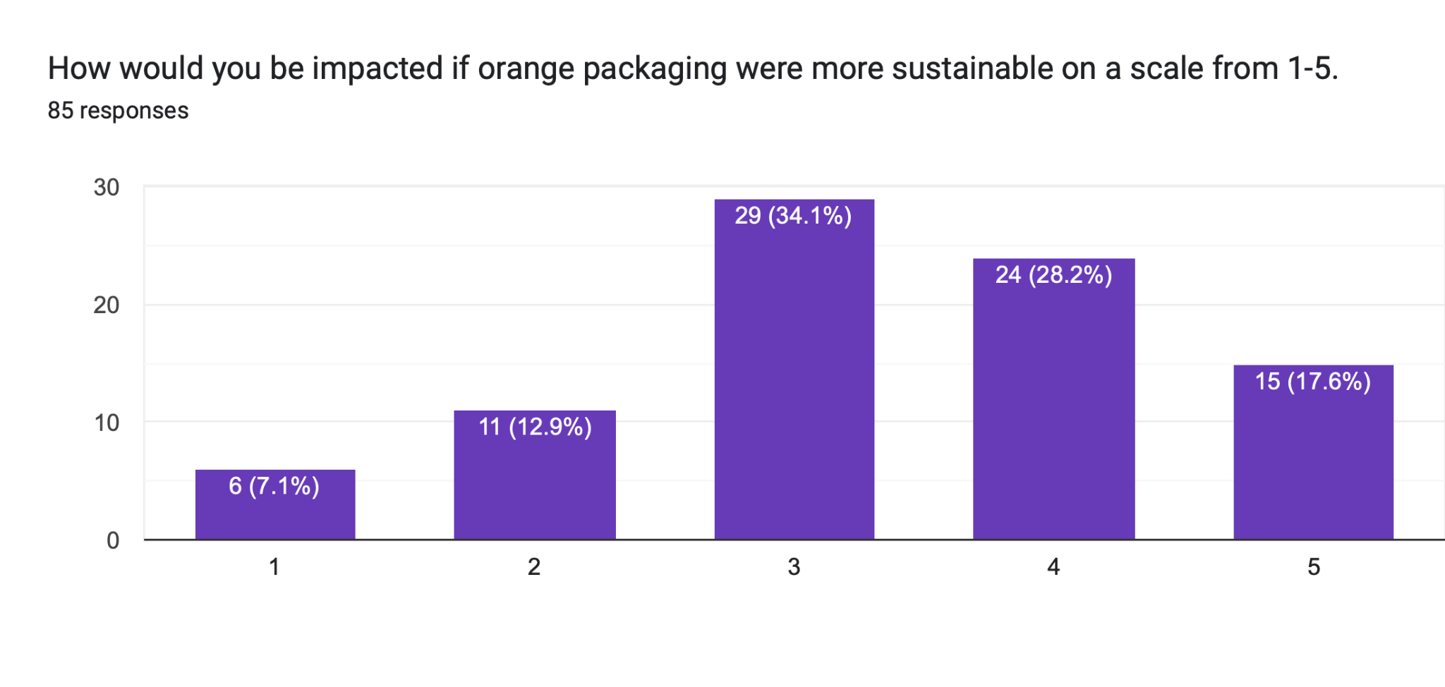
Survey
Notes:
Top chart shows that people feel orange packaging is not too expensive, but it is something they value.
Bottom chart shows that people wish orange packaging (80%) were more sustainable

Slide 10
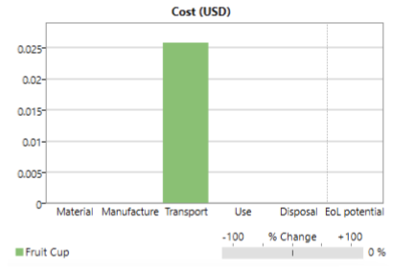
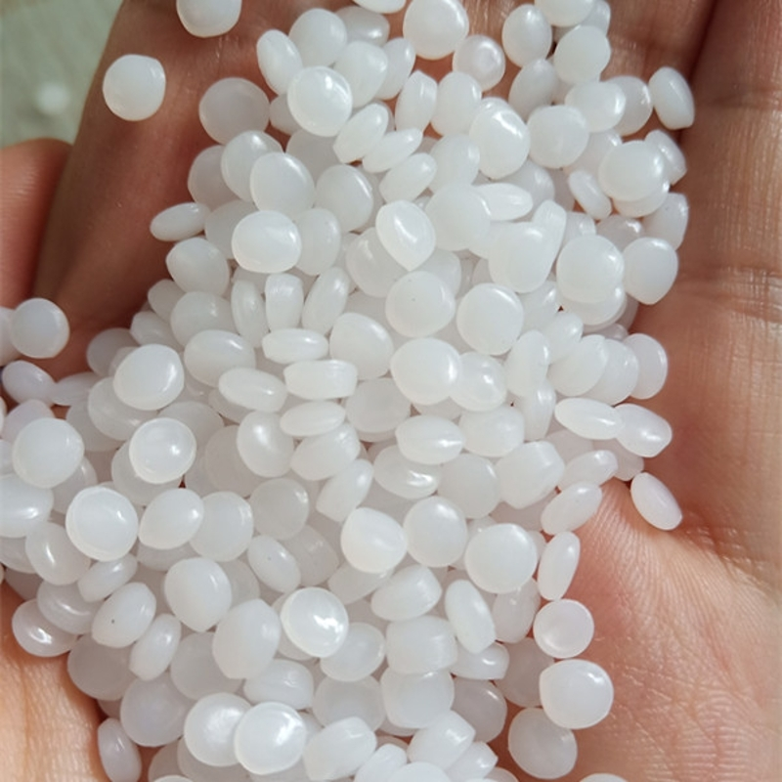
Profit/Costs
Polypropylene
PP and PPE
Success of PP and PPE dependent upon their popularity and cost-effectiveness
Major costs for PP are derived from transportation and storage from manufacturing facilities.
PP costs between $0.55-$0.80 per kg
  Both PP and PPE share similar costs
Why so cheap?
  Easily sourced from petrochemicals
  Reduced energy requirement
  Easily extrudable
  Competitive market
    Compounded annual growth rate of 4.7% for the world market
    PP accounts for 16% of plastic industry production in the world market.

Slide 11
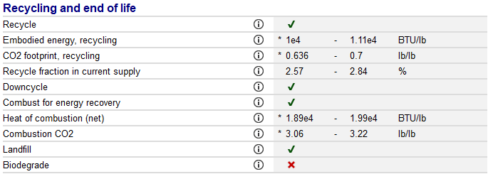
Environmental
PP Environmental Impacts
PP derived from fossil fuels/crude oil; derived as a byproduct from ethylene production.
  9.34 kWh of energy used
  1.67 lbs of CO2
1% of PP is recycled; 22-43% of PP ultimately ends in landfills however these numbers are expected to be much higher.
  Can leak vinyl chloride, dioxin, and cadmium into the surrounding environment.
Non-biodegradable; average lifetime of 30 years.
No conclusive legislation on end-of-life treatment for PP.
Polypropylene (PP)

Slide 12
Polypropylene Source
1
2
3
4
Petroleum Oil
Refinery
Sourced domestically from Texas, New Mexico, and North Dakota.
Majority of PP produced domestically, but domestic production declining 2% a year.
Natural gas processing to isolate hydrocarbons such as propane.
Steam Pyrolysis: breaking down propane and hydrocarbons, propylene created as a byproduct.
Polymerization
Pelletization
Ziegler-Natta Process
Metallocene Catalyst System
Propylene undergoes chain reaction to become a powdered polypropylene.
Polypropylene is pelletized to form small granular plastic resin.
Final step before it’s melted during manufacturing to form mesh bagging.

Slide 13
03
Changes

Slide 14
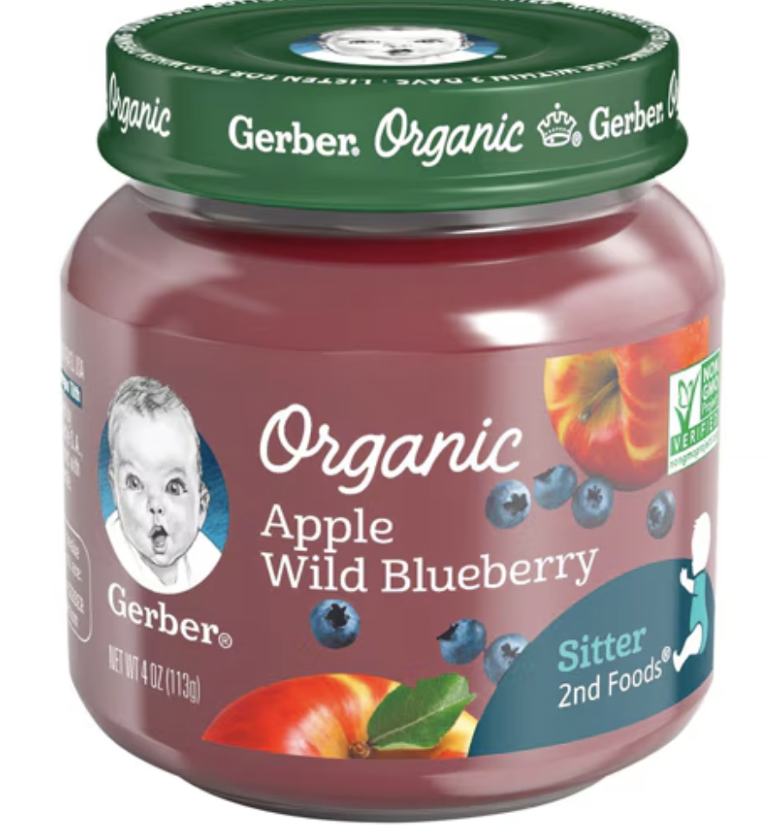
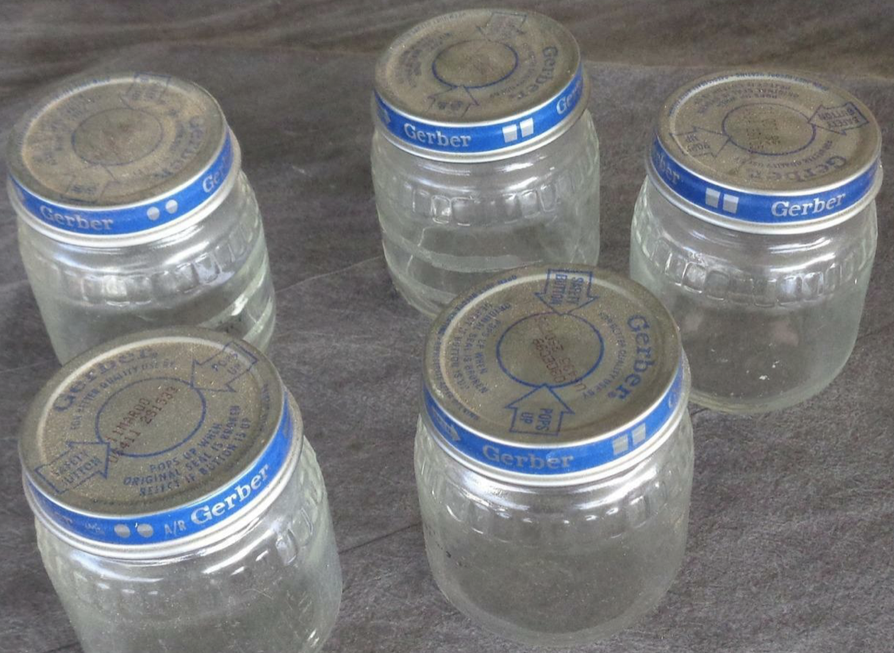
Fruit Cup - Sustainability
Replace the main material of the fruit cup (the polypropylene base and lid) with a glass jar design
Glass is cheaper, much more recyclable, and reusable
  Decreased risk of plasticizers and phthalates because they are not in glass
  Increased safety and less health risks
Small jars (like baby food)
  Easy and quick snack

Slide 15
04
Impact of Changes

Slide 16
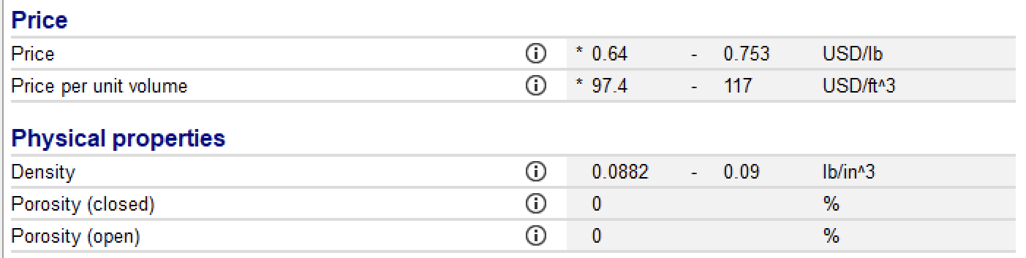
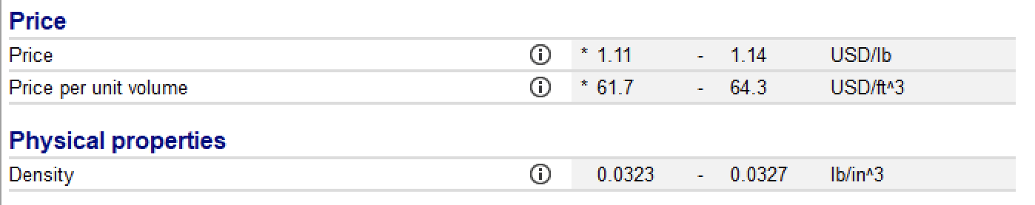
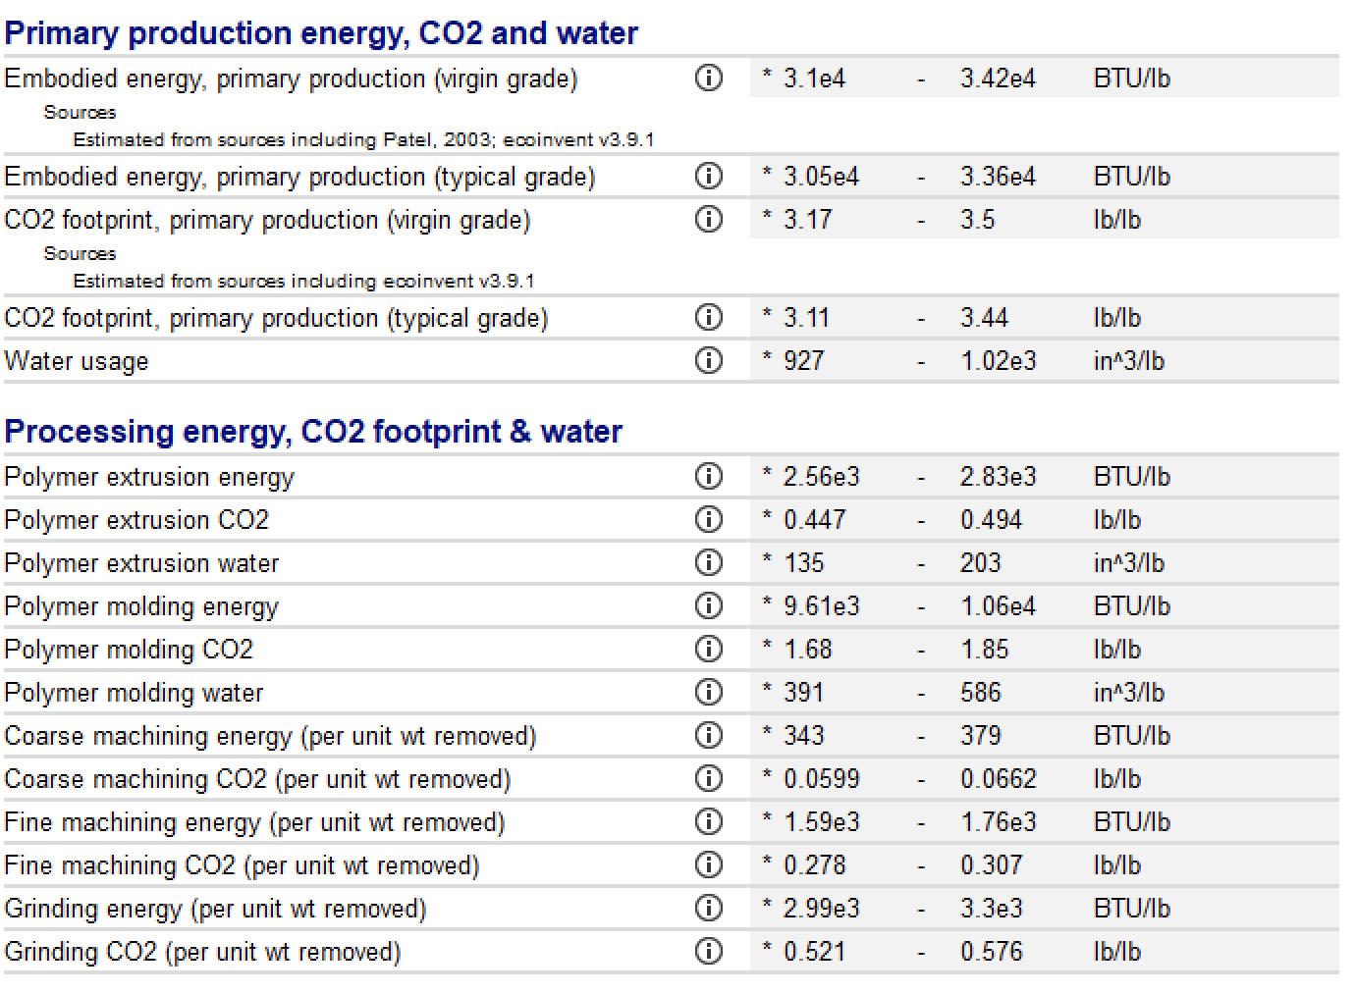
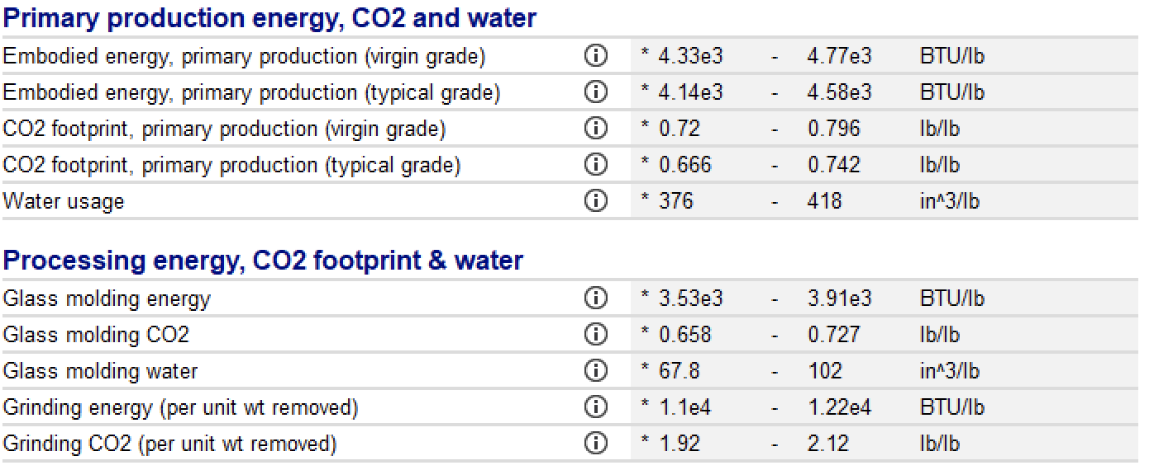
Polypropylene
Soda Lime Glass

Slide 17
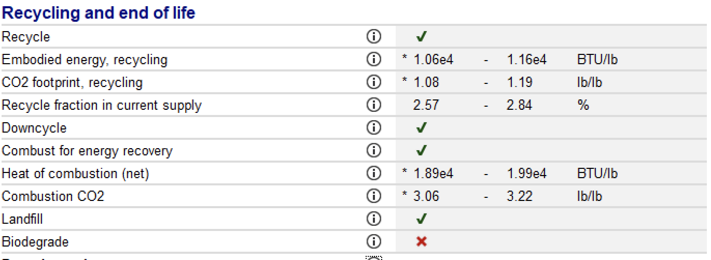
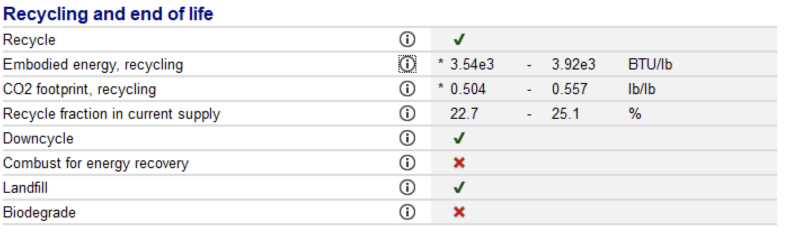
Polypropylene
Soda Lime Glass
The overall energy use and carbon footprint in the end of life and recycling process is much less for soda lime glass than it is for polypropylene
The recycled fraction in supply for glass is almost 10 times greater than for PP, which highlights how it is more sustainable
PEOPLE - safer and fits all needs and wants of sustainability
PROFIT - cheaper ! for energy and price
PLANET - more sustainable, better end of life disposal and recovery
Notes:
Remember to discuss downsides: density, price per volume, fragile

Slide 18
05
Evidence and​​ Testing

Slide 19
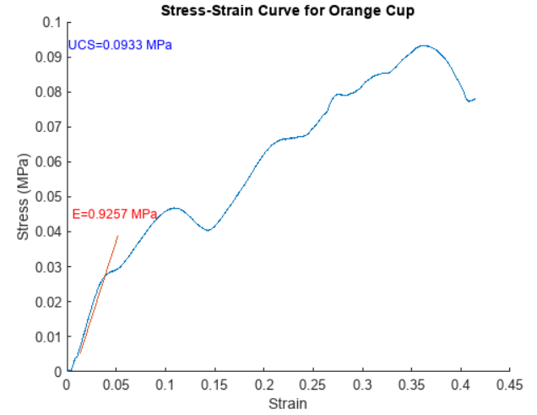
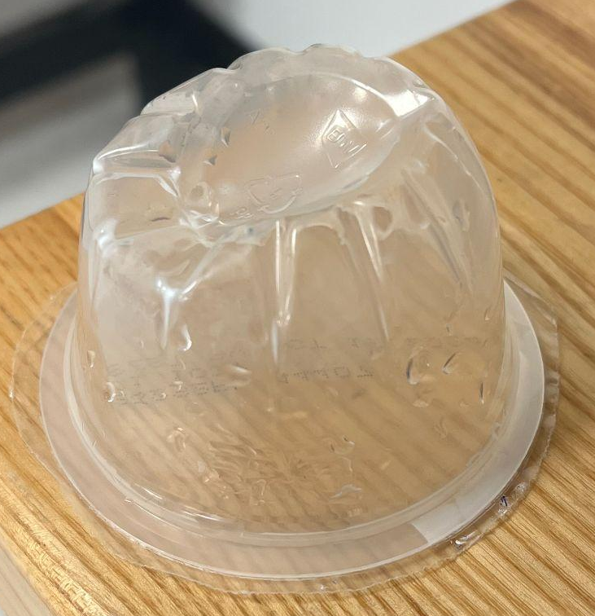
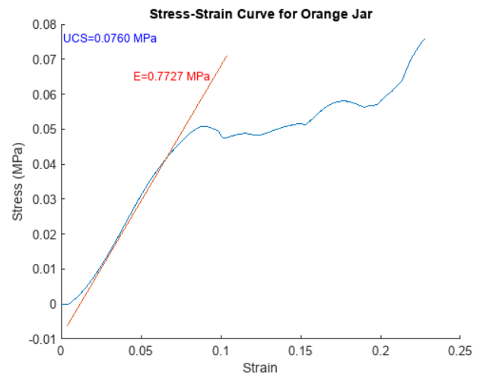
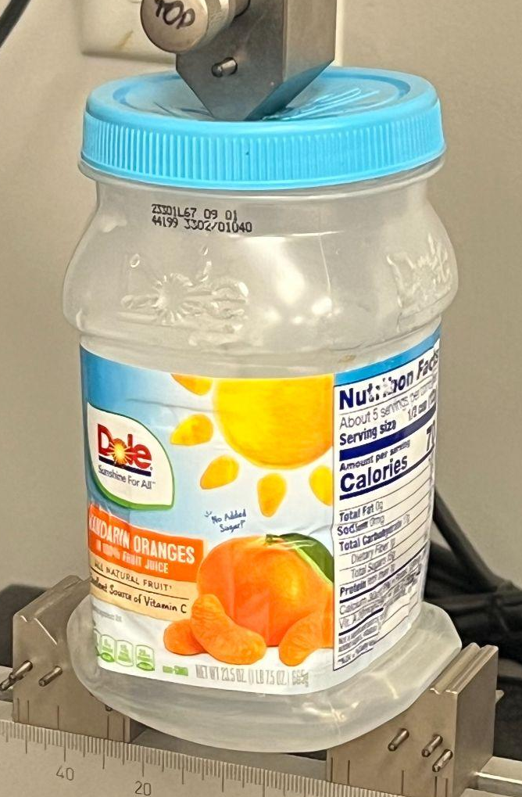
Compression Testing Results

Slide 20
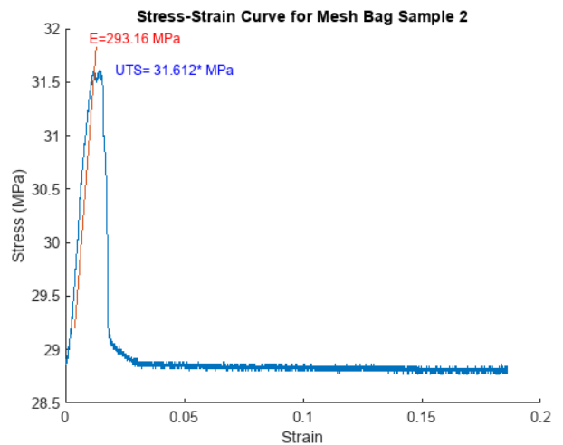
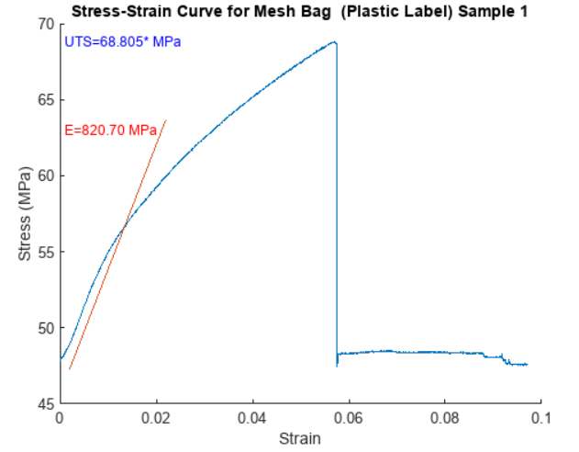
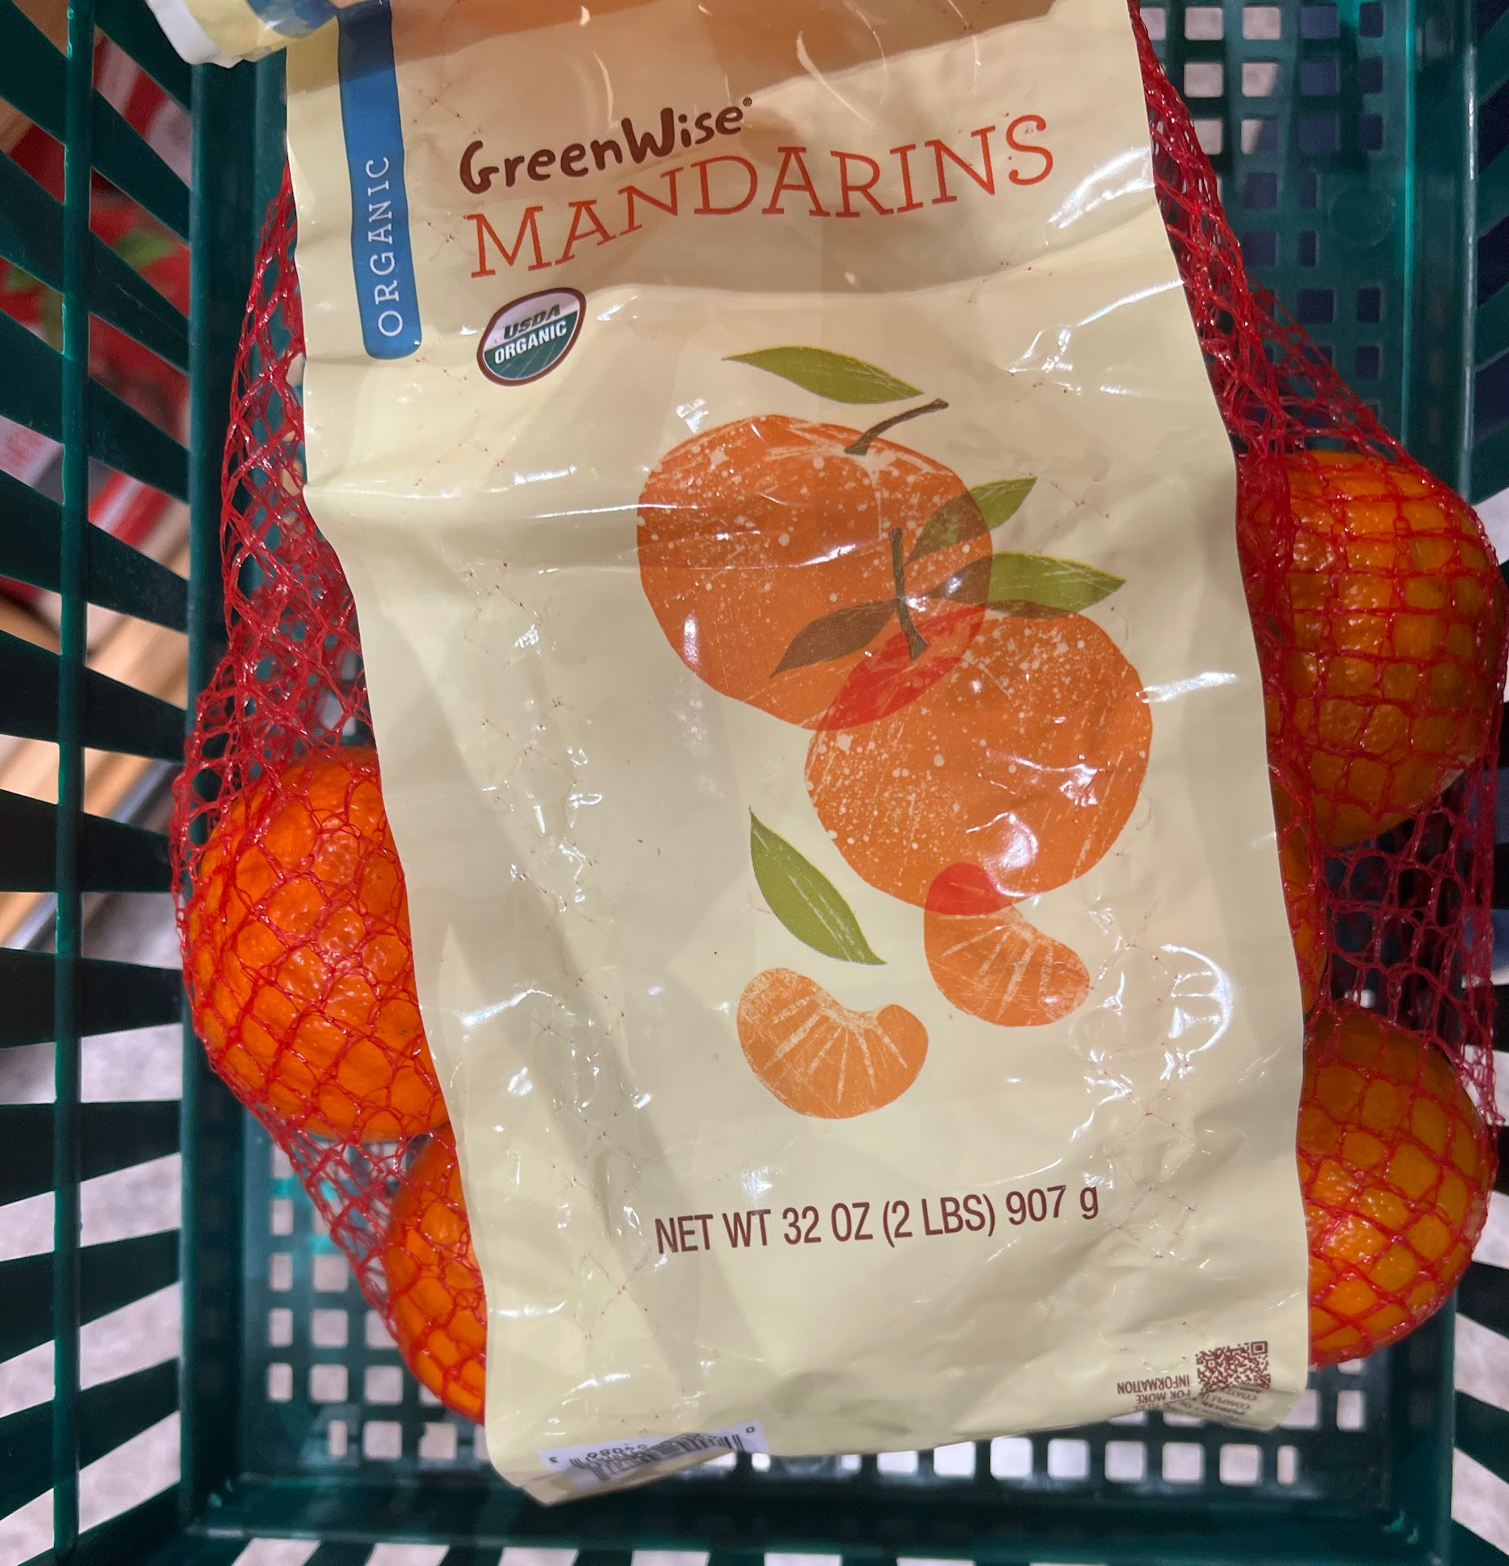

Slide 21
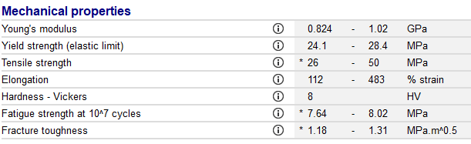
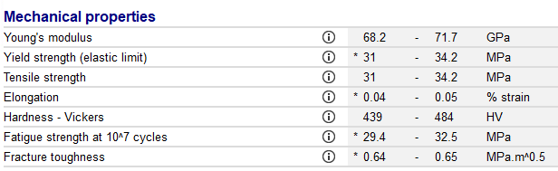
Property Comparison
Polypropylene
Soda lime glass

Slide 22
Phthalates and PFAS

Slide 23
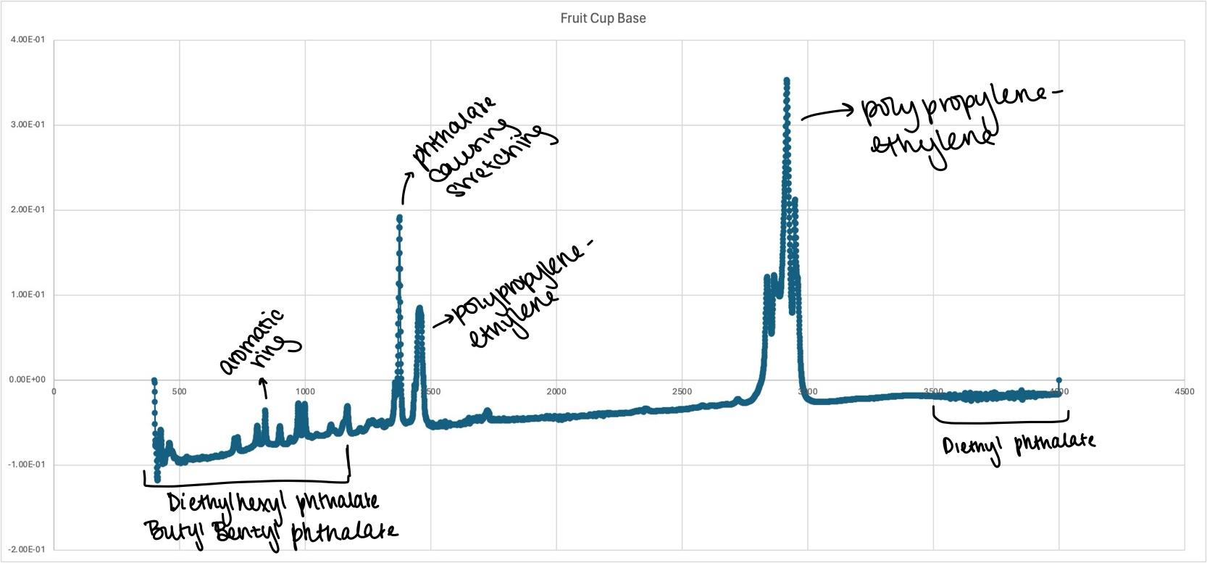
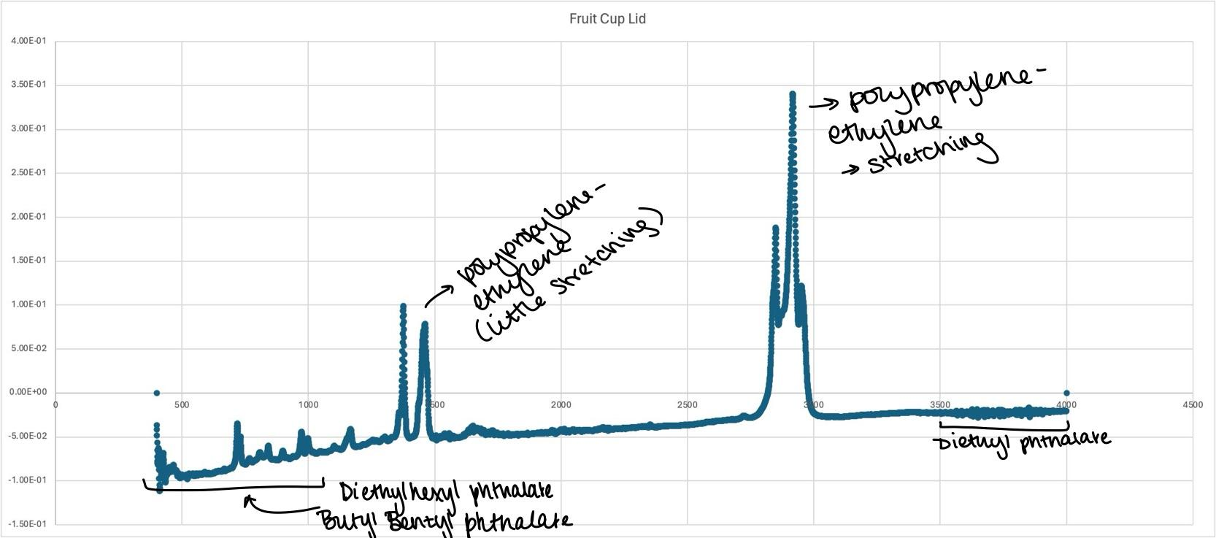
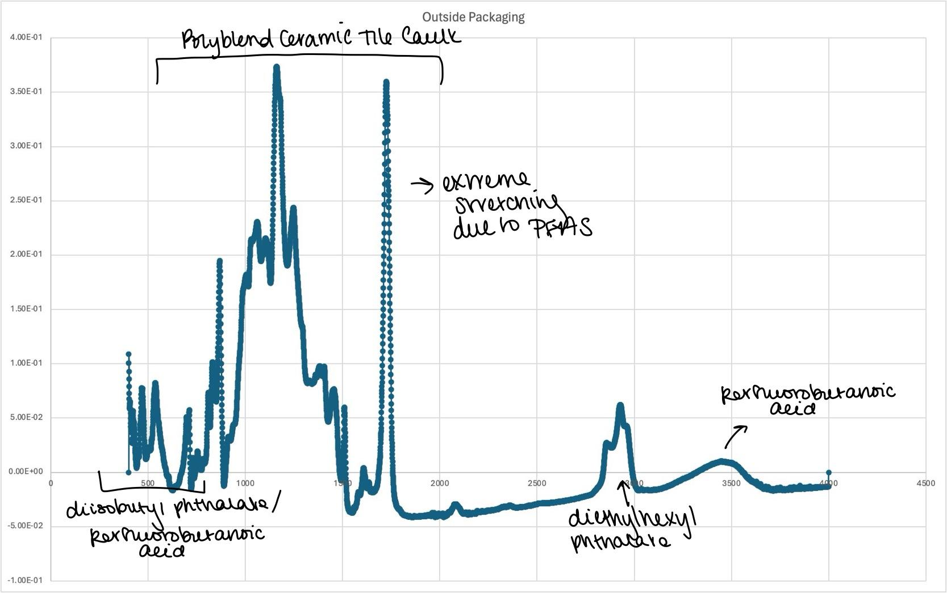

Slide 24
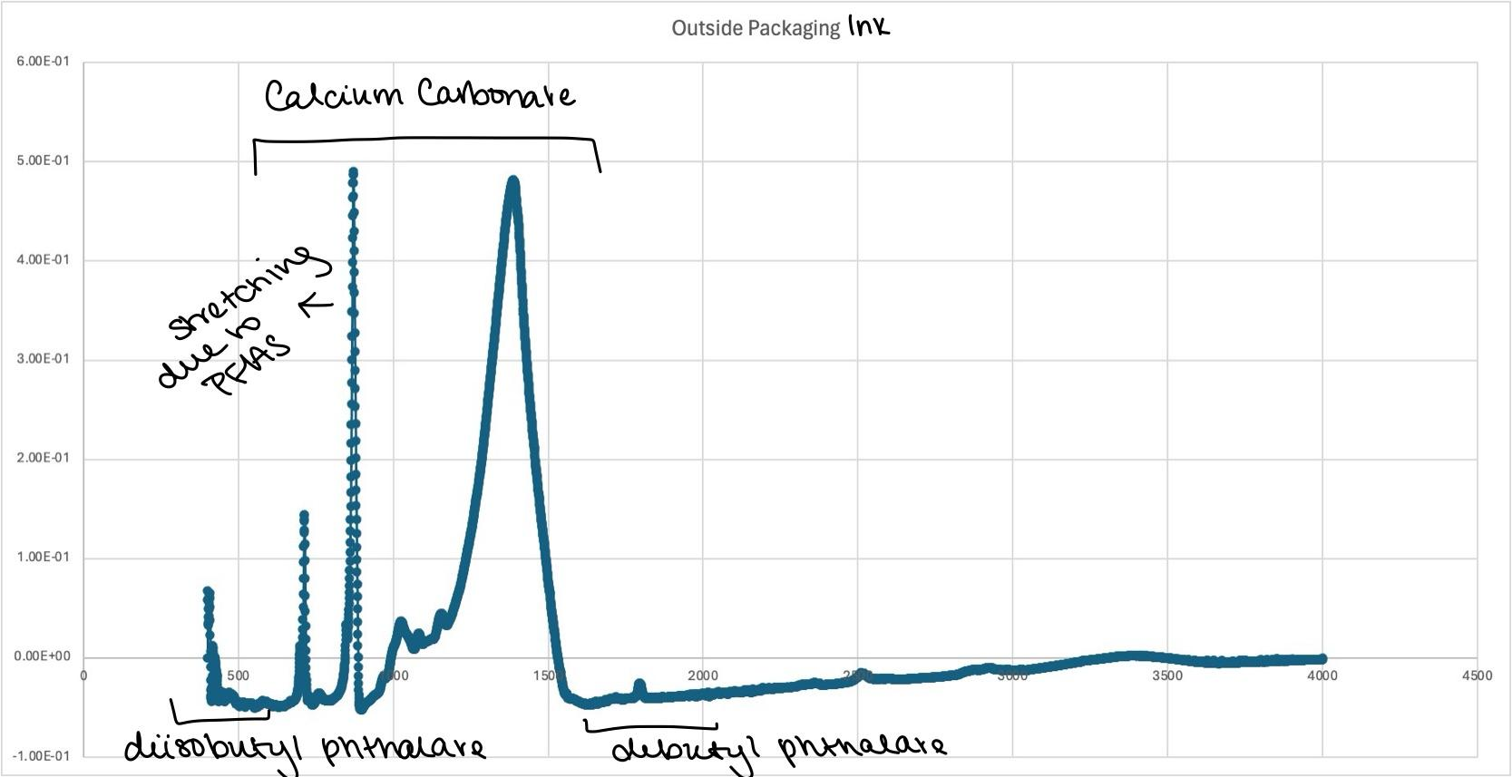
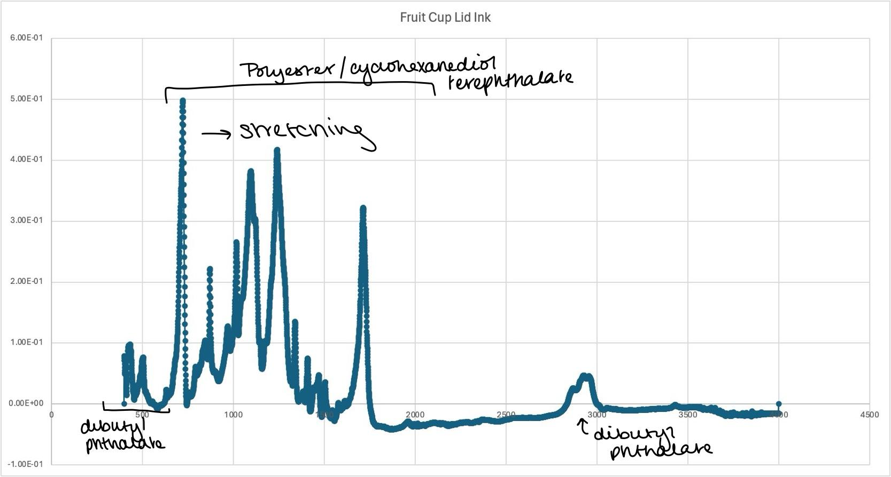
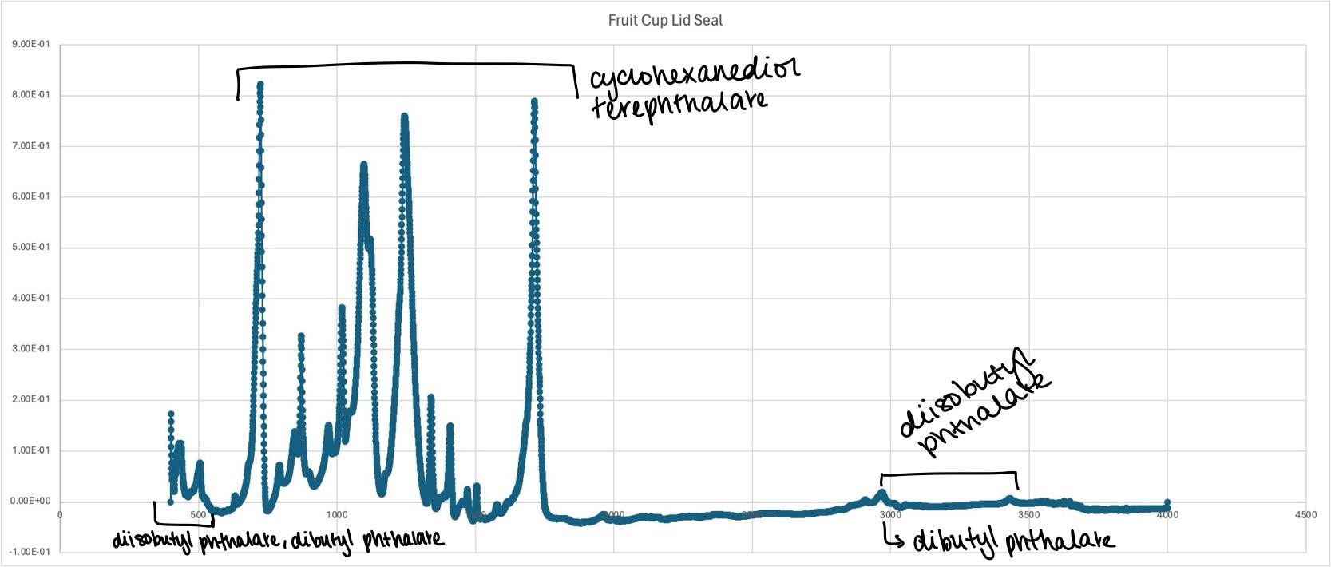

Slide 25
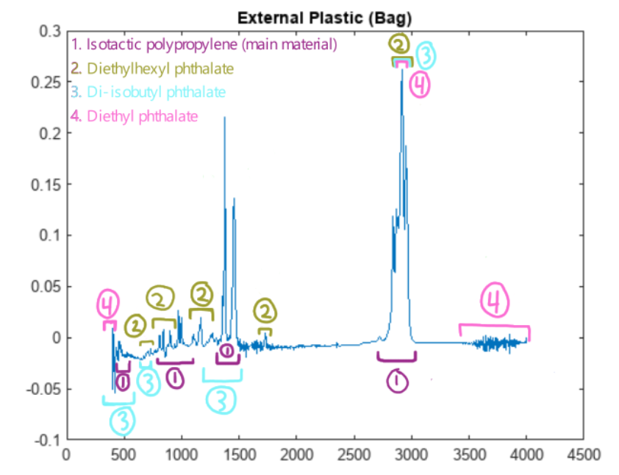
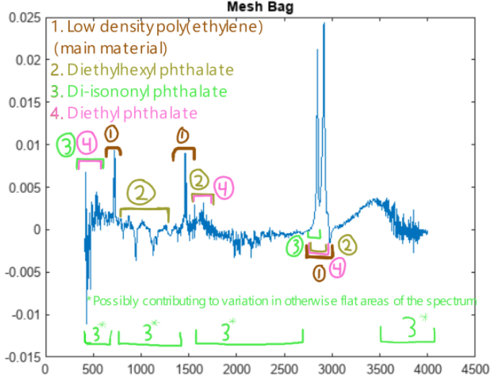
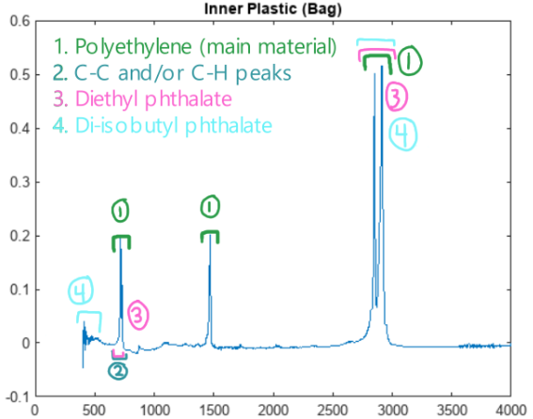

Slide 26
06
Market Plan

Slide 27

Strategy
Who?
Where?
Appealing to health-conscious consumers who care about the environment, but still want an inexpensive, convenient snack (parents, college students)
We plan to advertise in grocery stores and farmers markets, as well as putting out ads online and on social media
What?
How?
Focusing our marketing on the idea that these cups are more reusable, recyclable, food-safe, and (ideally) cheaper
Open and honest communication about where our materials come from and how they’re processed; allowing consumers to provide feedback
Notes:
Image source: https://dolesunshine.com/us/en/products/mandarin-oranges-in-100-juice-16oz/

Slide 28
Why buy our product?
Convenient, “grab-and-go” containers
Inexpensive
Reusable cups help you get more for your dollar
Environmentally-friendly alternative
  Reduced carbon footprint and water use
  Easily recyclable- less landfill waste
Safer to consume- no harmful plasticizers added

